Slide 1
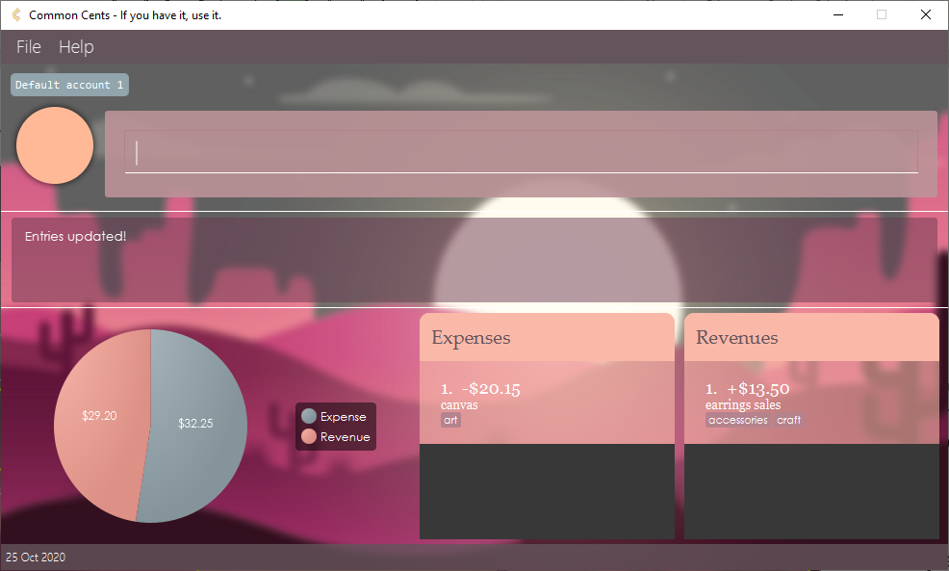
Feedback indicating that the lists are updated
Only entries with keywords earrings and canvas are shown

Slide 2
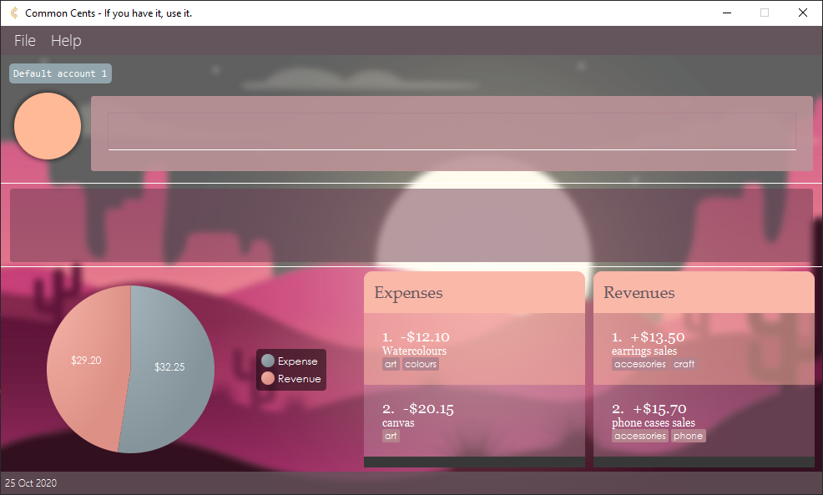
Menu bar
Active account name
Display picture
Command box
Result display
Account summary chart
Status bar
Chart legend
Expense list
Revenue list

Slide 3
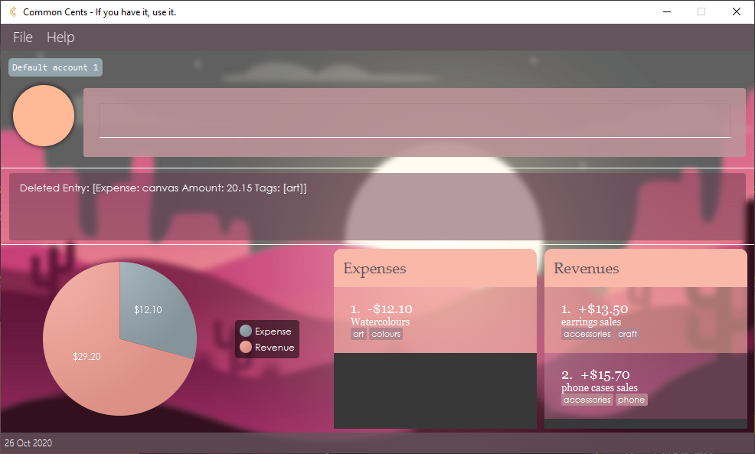
Feedback indicating that an expense called canvas is deleted
The canvas entry no longer shown in the list

Slide 4
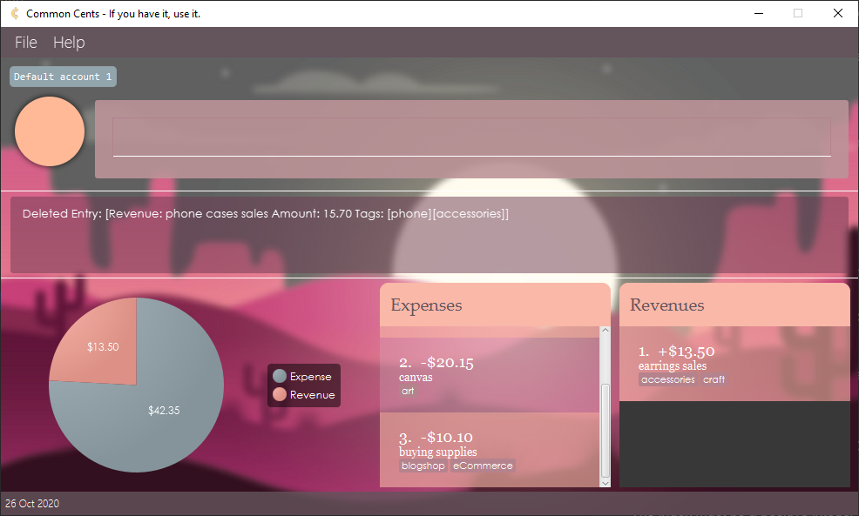
Feedback indicating that a revenue called phone case sales is deleted
The entry no longer shown in the list
The pie chart is updated

Slide 5

Feedback indicating that the deletion has been undone
The canvas entry is shown again

Slide 6

Feedback showing the profit of the current account

Slide 7
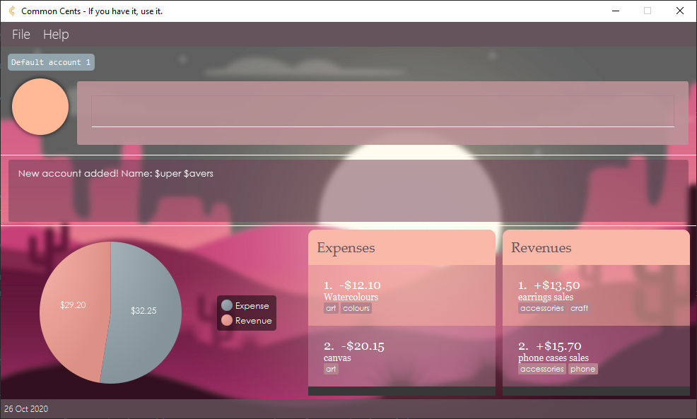
Feedback indicating that a new account called $upper $avers has been added

Slide 8

Feedback indicating that an account called My Flower Shop has been added

Slide 9
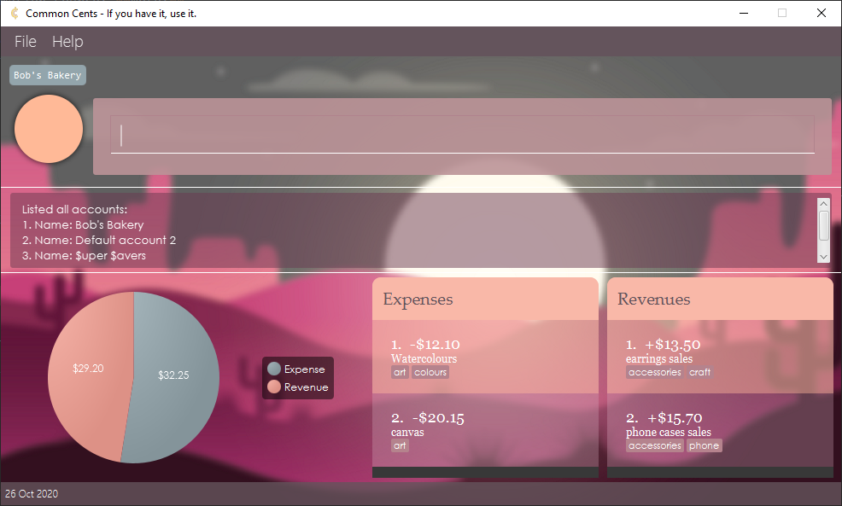
Feedback listing all the accounts

Slide 10
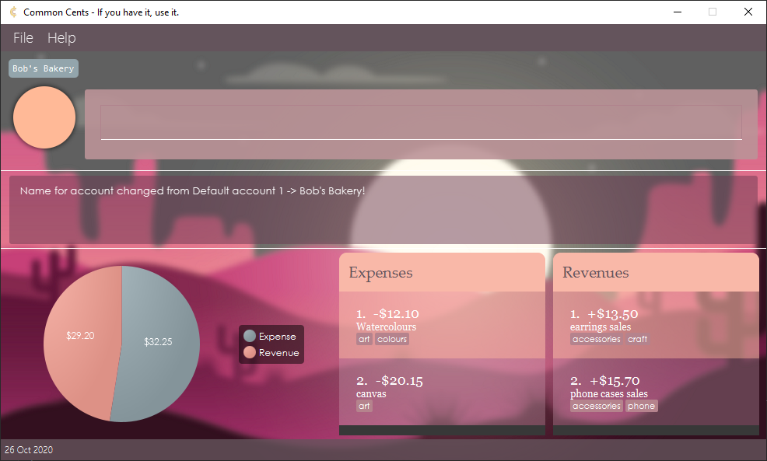
Active account name updated
Feedback indicating that current account has been renamed to Bob’s Bakery

Slide 11
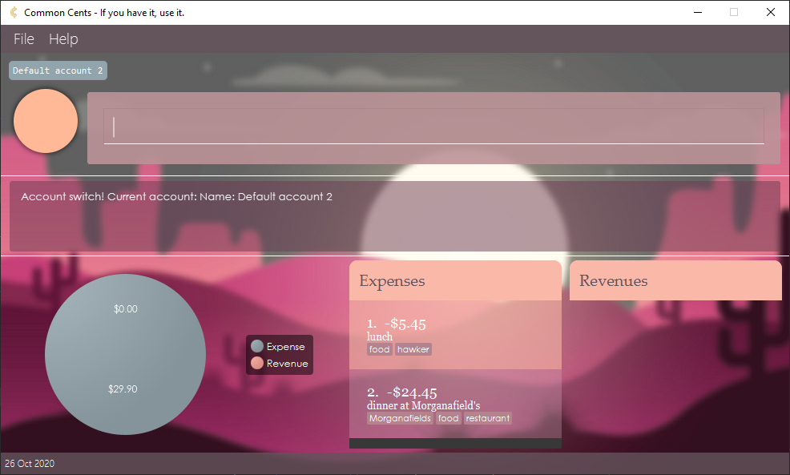
Active account name updated
Feedback indicating that current account has been switched to Default account 2
Active account’s entry info updated

Slide 12
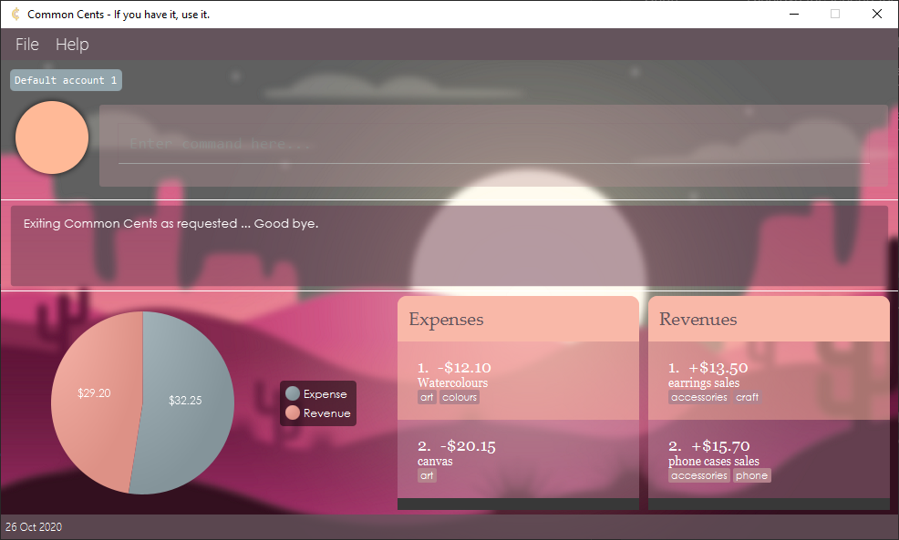
Feedback indicating exit message

Slide 13
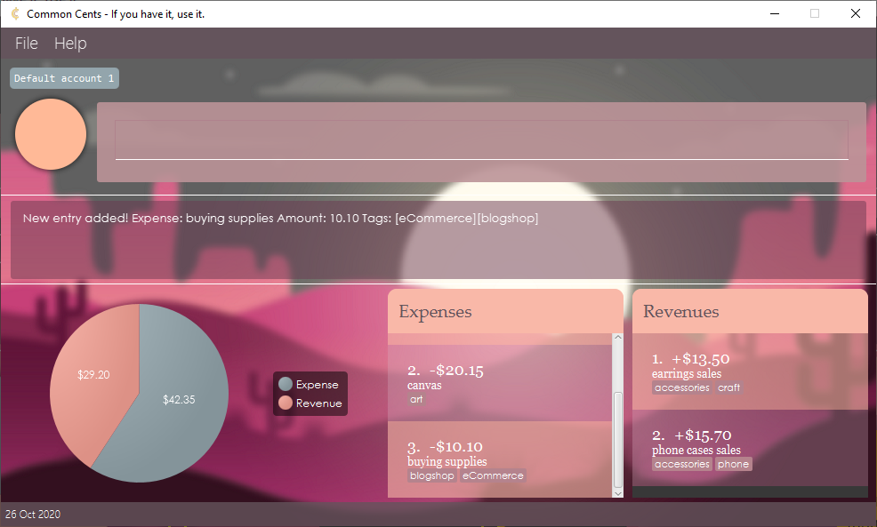
Feedback indicating that an expense called buying supplies is added
The pie chart is updated
The expense is added in the list

Slide 14
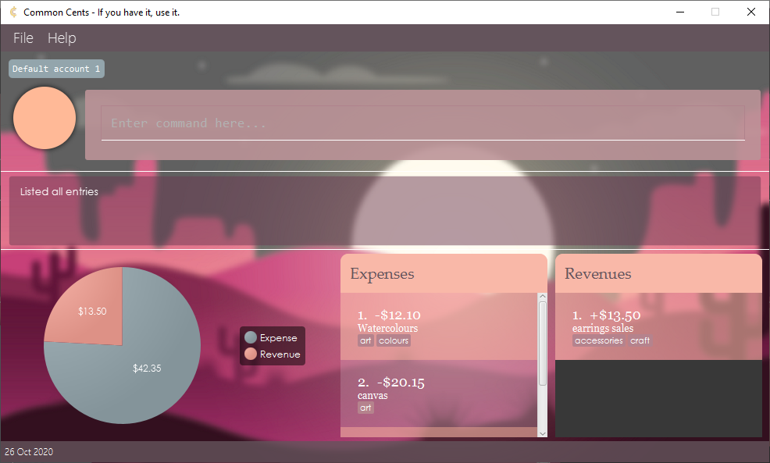
The targeted expense

Slide 15
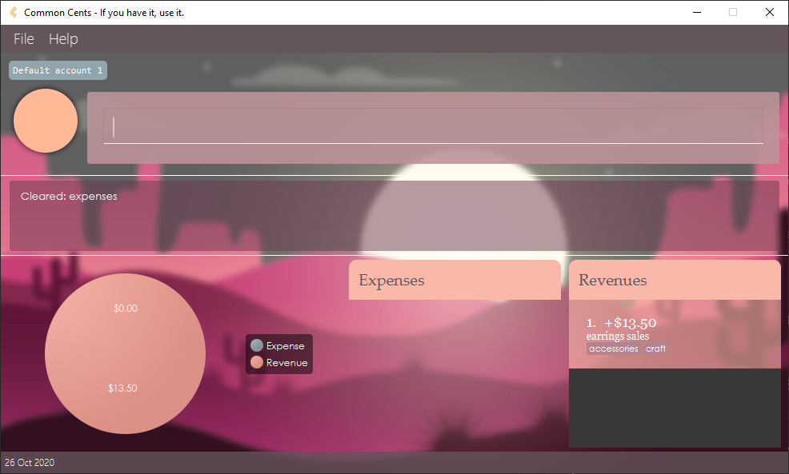
Feedback indicating that the expenses has been cleared
The pie chart is updated
All expenses visible in the list are cleared

